Slide 1
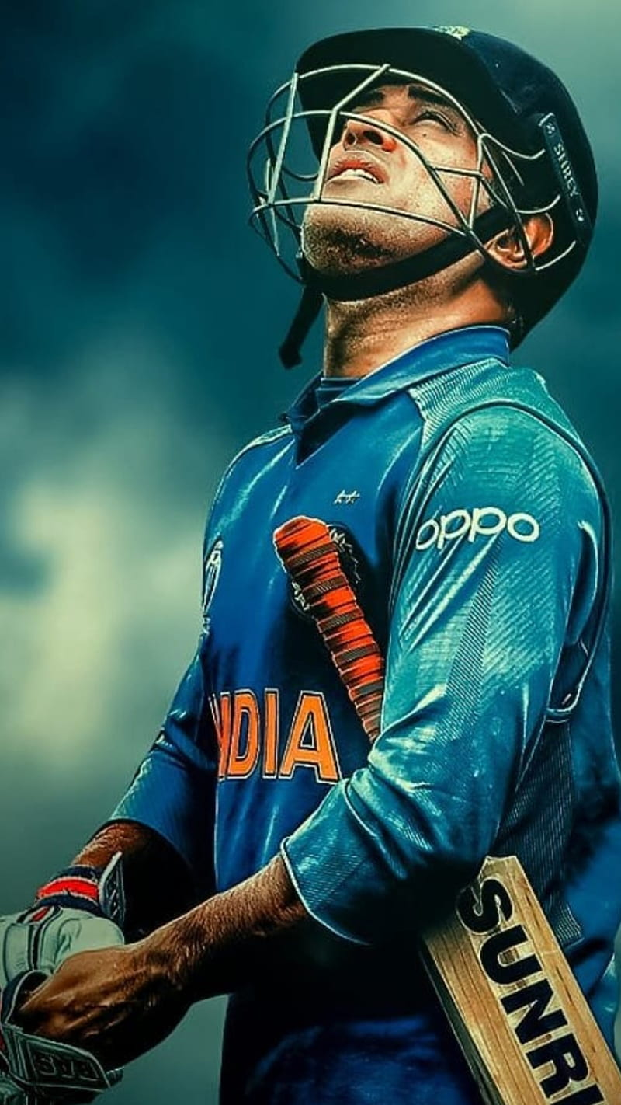
ULTRA EDGE TECHNOLOGY :-
OUR TEAMATES
PRIYANK
VINAYAK
JOEL
ABHISEK
SAMARTH

Slide 2
ULTRA EDGE TECHNOLOGIES :-
Ultra Edge technology is a cricket-specific technology that uses ball-tracking and sound sensors to determine whether a batsman has hit the ball or not. Here are some ways that Ultra Edge technology is transforming cricket:
Umpiring Decisions
Improved Spectator Experience
Player Analysis
Fair Play

Slide 3
HOW AI WORKS :-
Use of AI Technology: AI algorithms can be used to analyze the data collected by Ultra Edge technology to provide insights into player performance and identify areas for improvement. AI can also be used to improve the accuracy of the technology by detecting and filtering out noise in the data.

Slide 4


Slide 5
MARKET OPPORTUNITY :-
Market opportunity: With cricket being one of the most popular sports in the world, there is a huge market opportunity for technology that enhances the fan experience and improves player performance
Promotion Plan:
Ultra Edge technology can be promoted through targeted advertising campaigns aimed at cricket boards, teams, and broadcasters. Companies can also showcase their technology at cricket events and tournaments to demonstrate its capabilities..

Slide 6
Growth Approach:
To grow in the market for Ultra Edge technology in cricket, companies can focus on improving the accuracy and reliability of the technology.
They can also develop new and innovative applications for the technology, such as analyzing bowler performance or tracking the trajectory of the ball.
Additionally, strategic partnerships can be formed with cricket boards and leagues to expand the reach of the technology and increase market share

